Slide 1
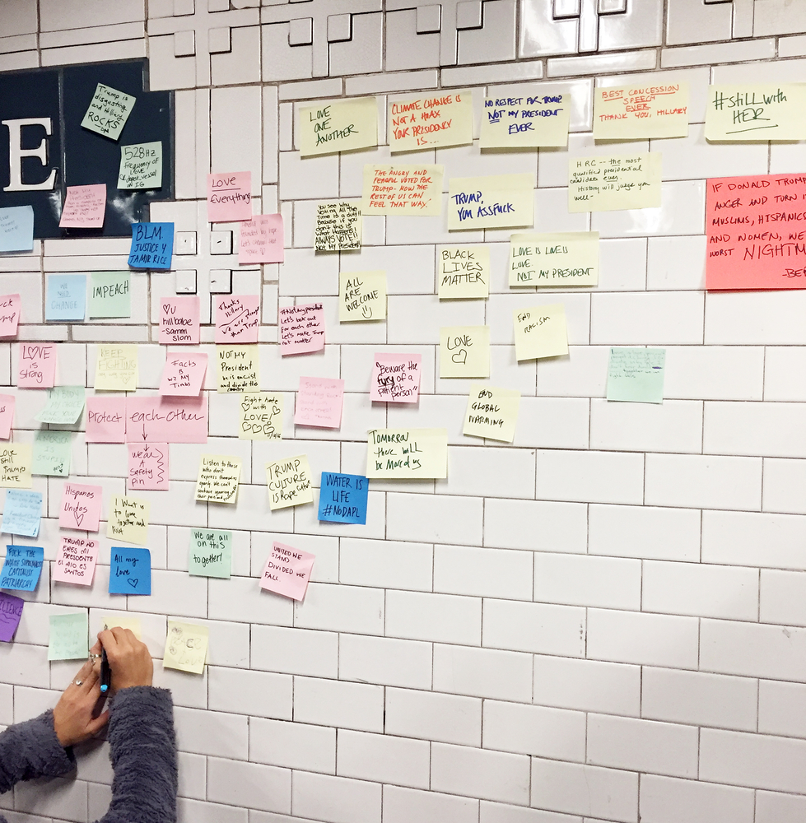
Post-Election 2016:
Changed Terrain Demands a New Orientation

Slide 2
In the Wake of an Historic Defeat, Orient Towards Our Central Objectives
This post-election discussion guide is organized in 4 sections:
Election Results
What to Expect from a Trump Presidency
The Work Before Us
The Changed Terrain Demands Reorientation
Limit Trump to One Term
Defend Our Communities
Build Progressive Power

Slide 3
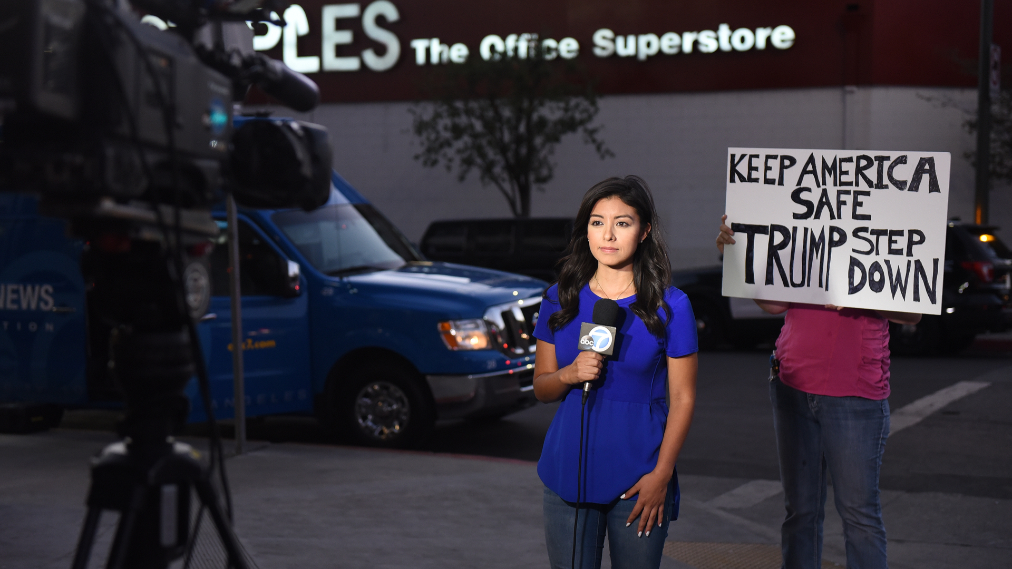
Part I: Election Results

Slide 4
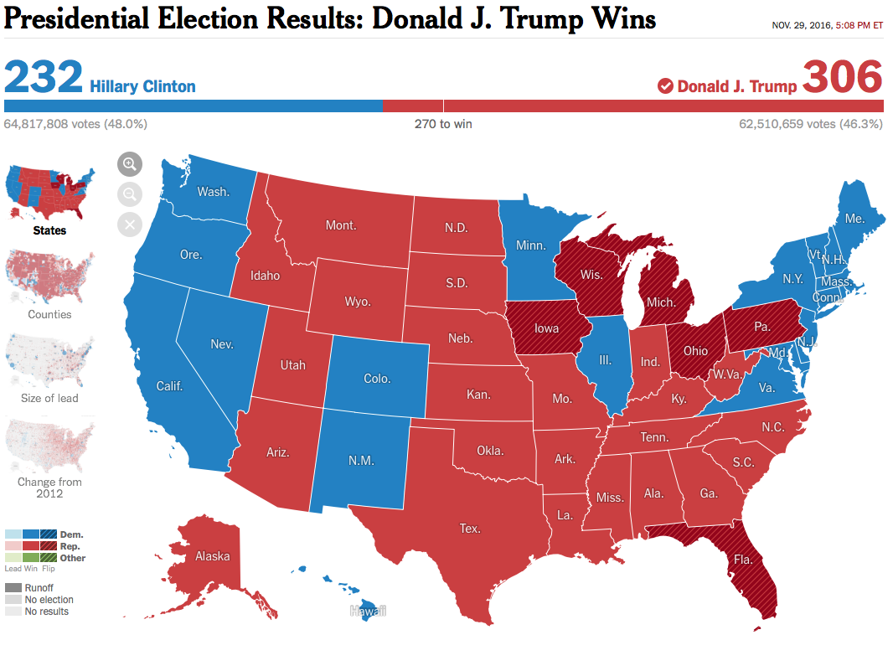
The Electoral
College Vote
Clinton Wins the Popular Vote by ~2 Million
Trump Wins the Undemocratic, Racially Rigged Electoral College, 306-232
http://www.nytimes.com/elections/results/president

Slide 5
The Upshot
Though he lost the popular vote, an aggressively racist, misogynist, authoritarian is now president-elect. He leads a party that controls the executive and legislative branches of the federal government and will soon command a conservative majority on the Supreme Court. Republicans also hold 32 governorships and both legislative branches in 32 states, including all the Southern legislatures, holding unparalleled dominance in governing power. This radical right turn, unprecedented in modern U.S. history, is the first populist movement to take control of a major political party.
Our main tasks on this new terrain are to defend our peoples and our democracy, build progressive power and make Trump a one term president.
The struggle against Trumpism and the far-right forces he mobilized will be a decades-long battle for the heart and soul of the country. All progressives and progressive organizations need to restrategize and reorganize to maximize their contribution to beating back the Republicans in 2018, defeating Trump in 2020, and defeating Trumpism across the country in the years ahead.
Progressives come out of 2016 with some notable strengths, but now face a steep fight against an absolutely hostile government, a galvanized Republican Party and base, and a weakened Democratic alliance. Trump’s victory gives urgency to addressing longstanding differences among progressives over race and class, electoral politics, and the priority of fighting the far right – differences which can and must be worked out in the course of struggle.

Slide 6
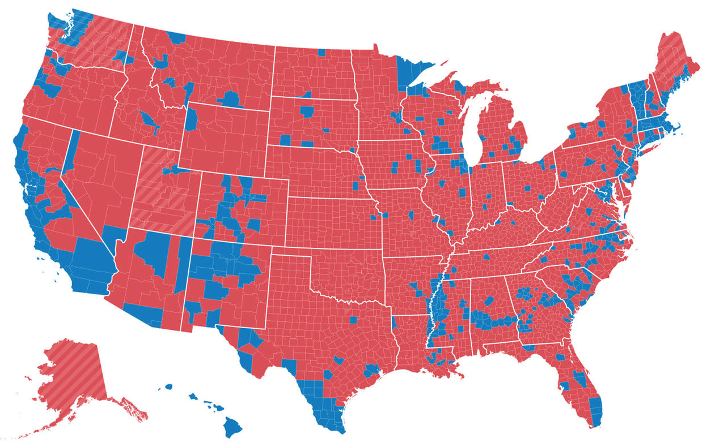
The Presidential Vote, County by County
https://www.facebook.com/photo.php?fbid=1543376042356023&set=pb.100000509267012.-2207520000.1479705003.&type=3&theater

Slide 7
Racist, Misogynist, Nativist Authoritarianism (Trumpism) Takes Power
The most important dynamic of the election – the dynamic that put power in the hands of the far right – was the dramatic growth and mobilization of that portion of the white electorate prepared to back an openly white supremacist, nativist and misogynist candidate.
Despite his huge lurch to the right, Trump got about the same percentage of the white vote as Romney, about 58%. Since Johnson and Stein voters – about 5 percent of the electorate – were overwhelmingly white, this meant Clinton’s 37% share of the white vote was significantly below Obama’s 43% in 2008 and 39% in 2012.
Anger at elites and the stalled economy are critical issues, but Trump’s base was laced together by racial fear of the relative population growth of people of color, anti-immigrant and anti-Muslim fervor, and resistance to both the equality of women and the assertion of LGBTQ rights.
Trump’s support was strongest among white men (63%), especially those in lower and middle income brackets. Whites with less than a college degree voted for him at about 14 points higher than they did for Romney, which offset Republican losses of about ten points among whites with college or graduate degrees, as compared to 2012.
A big surprise for some was that white women, who many expected to desert Trump, gave him 53% of their votes, the same percentage as for Romney in 2012.

Slide 8
The Rising American Electorate Voted Democratic by a Smaller Margin than in 2012
All key sectors of the Rising American Electorate supported Clinton strongly, but below Obama’s win levels in 2012.
The Latino vote grew by one percentage point of the total electorate. Their vote is still in dispute: National Exit Poll says Latinos voted 65% for Hillary (versus 73% for Obama in 2012), Latino Decisions says 81%.
National Exit Poll says Asian vote grew by 1% of the electorate and voted 65% for Clinton, versus 76% for Obama in 2012. An Asian American poll says 75% for Clinton.
88% of Black voters chose Clinton. This was 5 points lower than their 2012 vote for Obama, a difference that is in part explained by a substantial Black gender gap: 94% of Black women voted for Clinton, versus 80% of Black men. Black voter turnout was 1% lower than in 2012. Voter suppression was also a factor.
Young voters: 55-37 for Clinton, 5 points lower than for Obama in 2012
Unmarried women: 62-33 for Clinton, 5 points lower than in 2012
Union households: 51-43 for Clinton, 7 points lower than in 2012
LGBTQ voters: 78-14 for Clinton, 10 points higher than for Obama in 2012

Slide 9
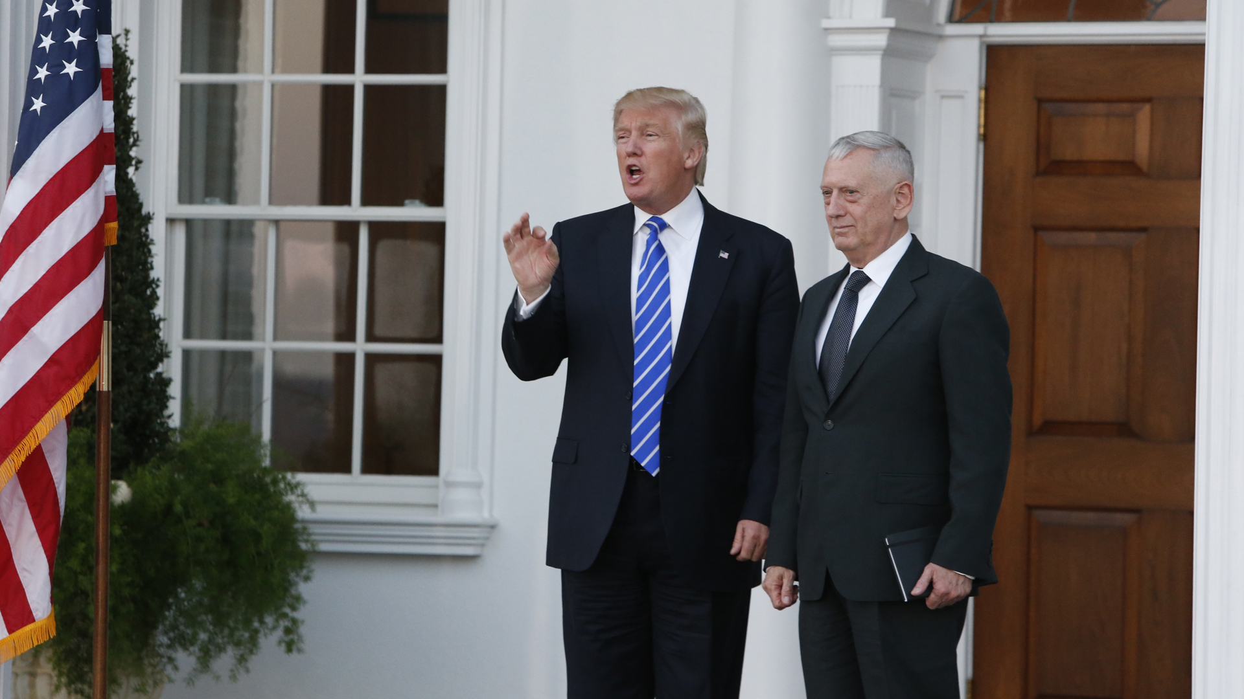
Part II: What to Expect from a Trump Presidency

Slide 10
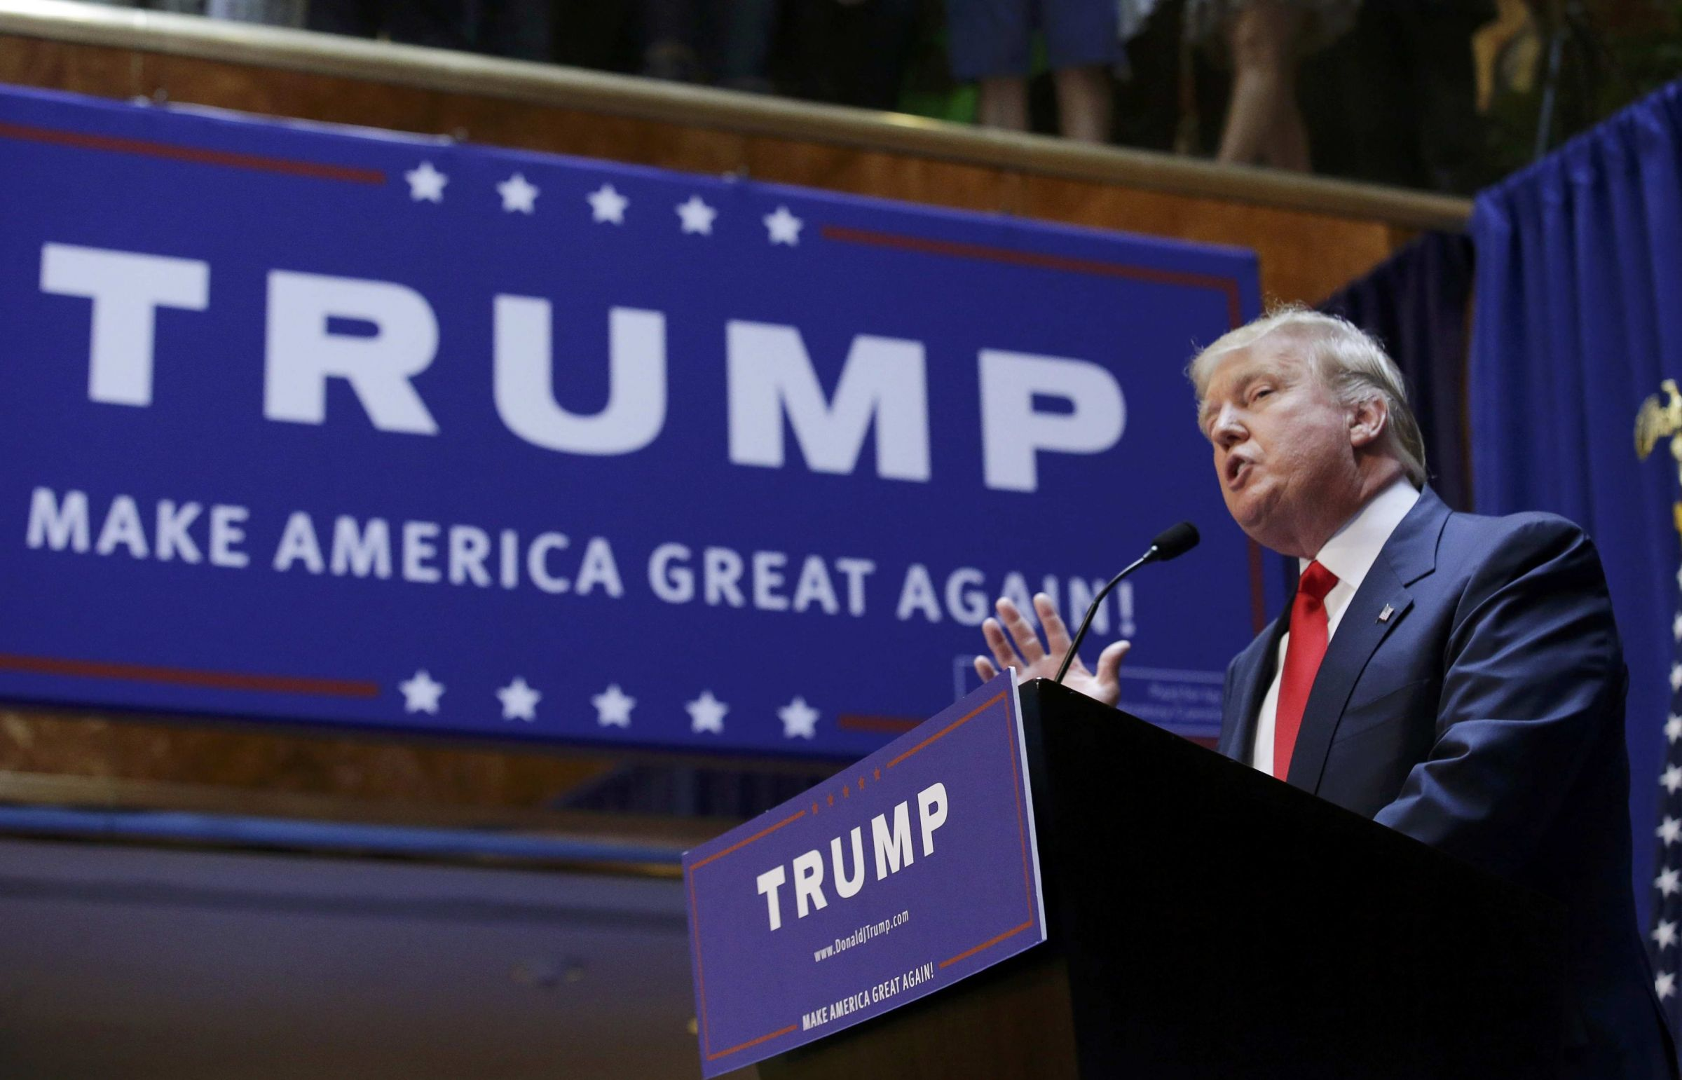
What to Expect from a Trump Presidency
A major realignment of forces
theocrats and white nationalists more prominent
Not just more of the same
very different than Nixon, Reagan or Bush II
This is not a drill
we face unprecedented dangers

Slide 11
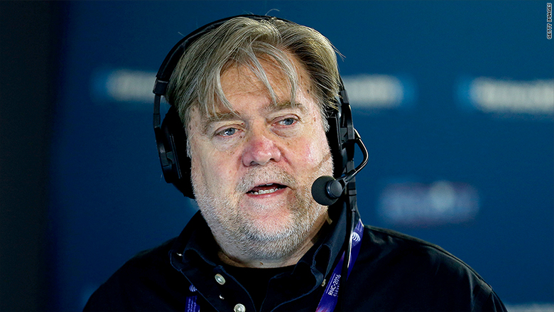
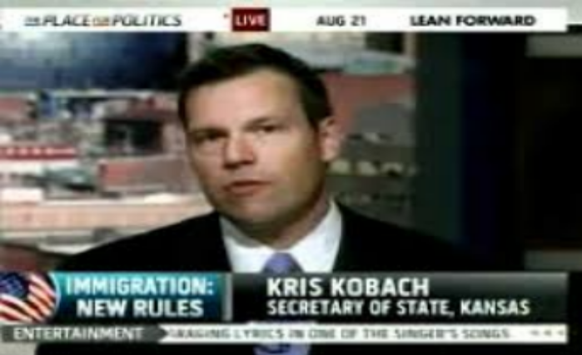
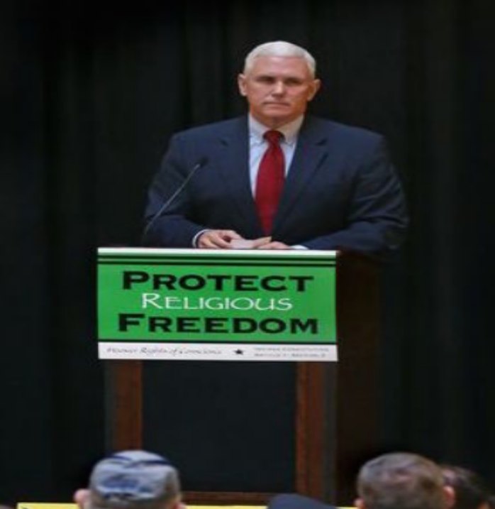
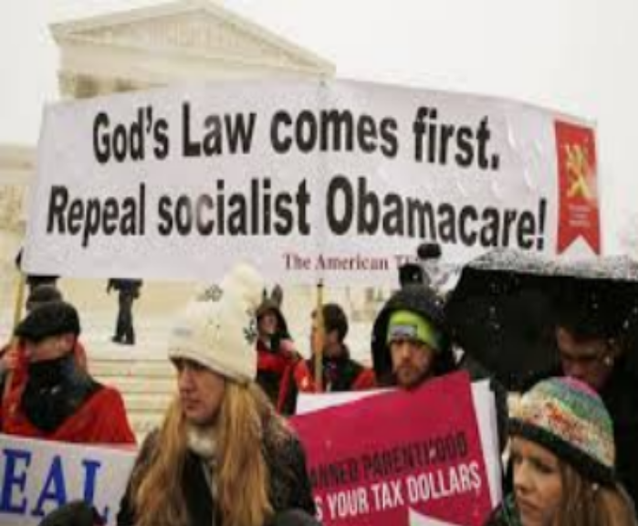
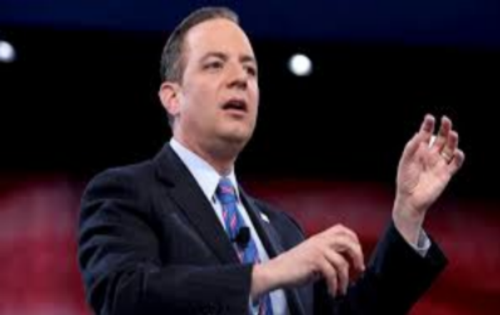

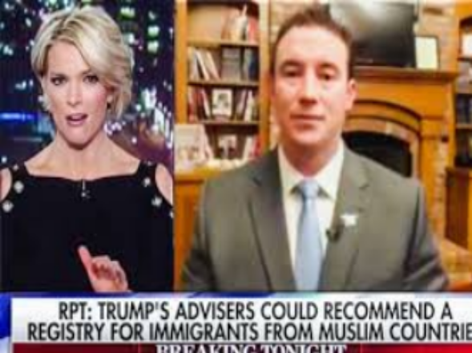
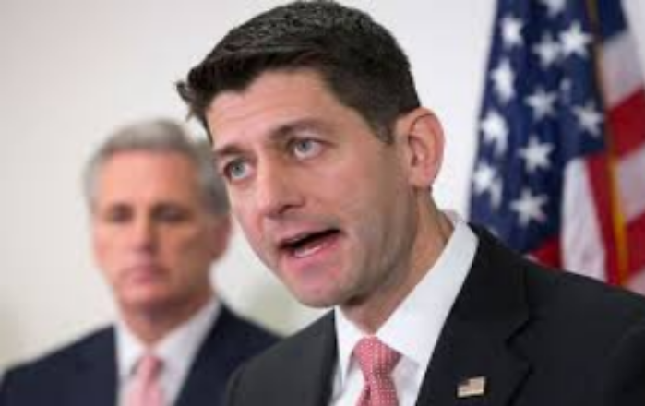
Trump’s Coalition
Far Right communications and legal experts within inner circle
Christian nationalists/theocrats in leadership
Reince Priebus, Ryan wing fall in line
Policy opportunities trump internal divisions over nativism, misogyny, economic populism/protectionism… for now

Slide 12
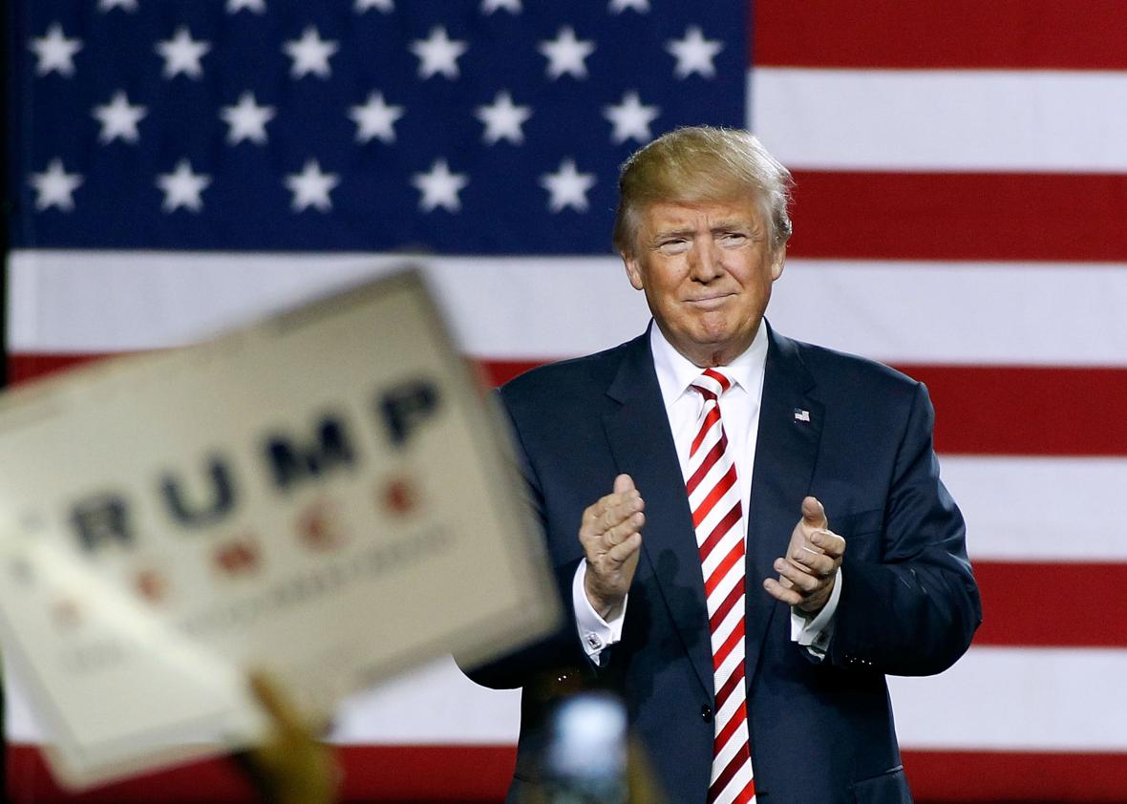
Trump Promises to:
Redeem the social standing of “real Americans” – White Christians
Harass, subjugate or expel racial, religious, and ideological enemies
Mix economic stimulus with privatization of government services
Resist any checks on executive power
Destabilize international relations

Slide 13
Sticks for Many
State Repression
Heightened persecution of Muslim communities
Mass immigrant deportations
Expanded policing powers, stop & frisk
Surveillance and repression of social movements, e.g., BLM labeled “terrorist”
Intimidation of the Press
Neoliberalism
Tax cuts
Privatization of services (e.g., education, Medicare) & infrastructure (e.g., highways)
Attack unions and end collective bargaining
Christian Nationalism
Religious exemptions trump civil rights & labor law
Churches can endorse candidates
Anti-choice SCOTUS
Defund comprehensive reproductive health
Roll back LGBTQ rights
Vigilantism
Organized white nationalists take cues from Trump
Individual acts of bigotry, aggression, bullying and violence
Climate
U-turn to fossil fuel economy
Climate change denial as official policy

Slide 14
A savvy Trump administration might move job creation while moving on mass deportations
Carrots for Some
Pro-Israeli Occupation
Could win support of Christian & Jewish Zionists, foreign policy hawks
Jobs
Approach to infrastructure investment, fossil fuel revitalization, and “inner city” spending could drive a wedge between authorized and unauthorized workers
Privatized approach to infrastructure could gain support of centrist Democrats
Wall St. Friendly
A booming market could defang resistance from some liberal & conservative quarters
Pro-Christian Supremacy
Could win sustained support of conservative Catholics & Protestant evangelicals

Slide 15
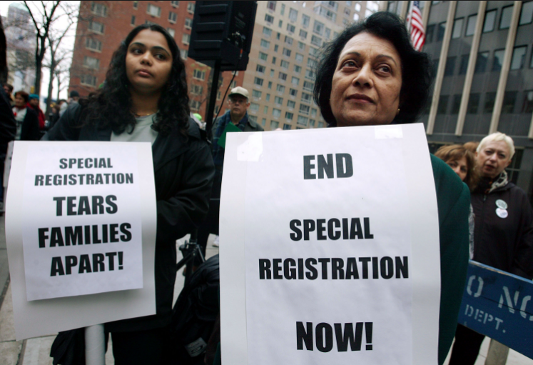

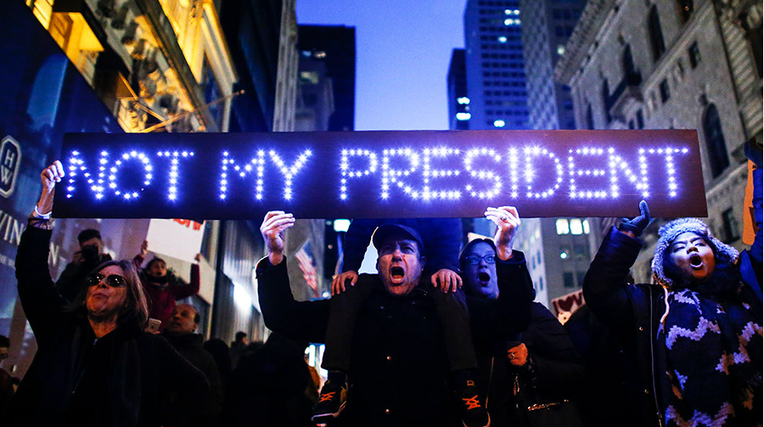
Social movements can contribute to creating a broad, mass-based oppositional force to fight the Trump administration and Trumpism.
Immediate resistance is needed to counteract the ‘give Trump a chance’ chorus and clarify that a Trump presidency is not ‘normal’ U.S. politics.
”If you come for any of us, you come through all of us.”
Welcome to the Fightback

Slide 16
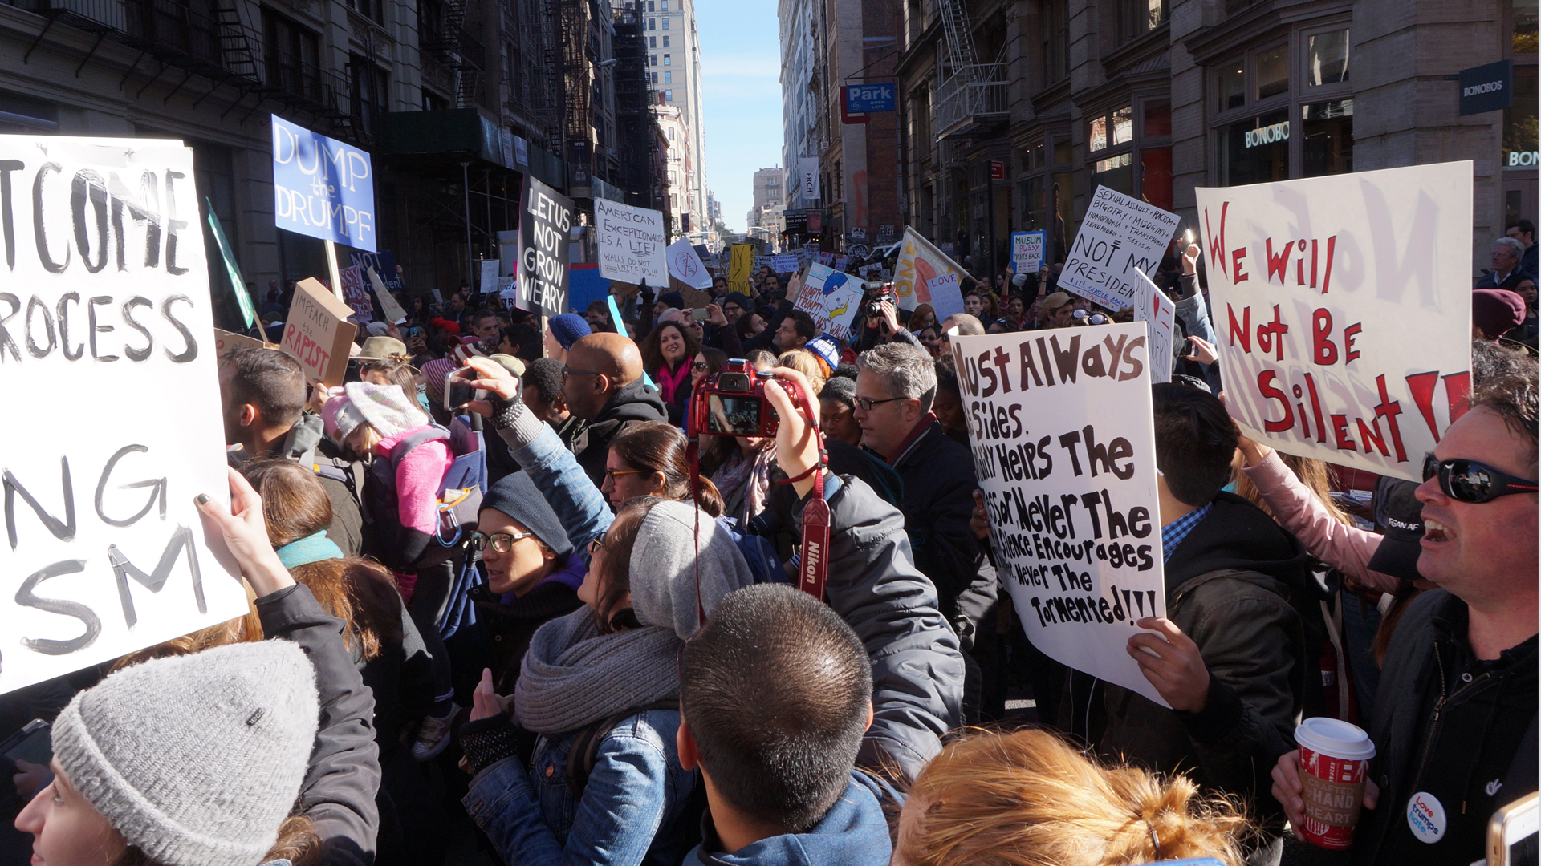
Part III: The Work Before Us

Slide 17
;
DUMP Trump in 2020
Trump will inflict a lot of damage in four years, some predictable, some unforeseen. We need to prepare now to hand him and Trumpism a resounding defeat in 2020.
Defend Our Communities
The threats of violence, deportations and a Muslim registry are very real. Defense of immigrant, Muslim and Black communities is a top priority.
Advance Progressive Unity, Build Progressive Power
We can expect a raft of regressive legislation and anti-democratic initiatives from a Trump administration. Building widespread, effective mass opposition to his presidency requires higher levels of unity and coordination, forged in the context of oppositional battles.
Three Massive Tasks Ahead:

Slide 18
Go big and go broad. Politics involves tens of millions of people. Now is not the time to cultivate left strongholds in miniature.
This moment requires a leap in every progressive organization’s functional capacity and strategic clarity. Each will evaluate strengths and weaknesses in light of radically changed conditions, and build on the hard work and rich experience gained up until now.
Within the broad anti-right alignment, different organizations will explore different approaches. Everyone is needed to defeat the right, no one has a monopoly on truth, and we are all likely to make mistakes.
Trump did not win a majority of the U.S. people, and some that he did win were motivated by frustration, disinformation and unfocused anger. The years ahead will be difficult and painful, but the majoritarian impulse toward democracy, equality and justice will reassert itself, as it has countless times in U.S. history.
Solidarity, Many Paths, Realism and Hope

Slide 19
Breaking the power of right-wing populism is a long-range task.
In the short term, a critical marker of progressive strength will be the capacity to limit Trump to one term. Defeating Trump in 2020 is the single most important step to set back Trumpism. We need to be clear-eyed and laser focused on this objective. This is our 2020Vision.
As long as Trumpism controls all three branches of government, we are on the defensive and no progress can be made on winning progressive reforms. Defensive fights – hanging on to what we’ve already won – are likely to be bitter and protracted.
On the other hand, defeating Trump in 2020, and setting back the GOP in the Senate, the House and in state governments, would open the door for a anti-right administration that could begin to undo some of the damage of the Trump period and initiate a different political direction.
If progressives can gain strength and coherence between now and 2020, and deny Trump (or a Trumpist) a second term, we may provoke serious divisions within the ranks of the right, creating more favorable terrain for influencing sections of their base and eventually marginalizing the far right.
2020 Goal: Make Trump a One-Term President

Slide 20
Mobilize immediately to defend our communities and our democratic rights, building our forces and establishing a pattern of fierce resistance to Trumpism.
Build majoritarian support for an anti-right agenda inclusive of racial, economic, and gender justice, peace, and defense of the environment.
Advance that agenda both in social movements and through electoral vehicles that can shape the 2020 contest, including the selection of a viable, inspiring candidate and a campaign that can unite anti-Trump sectors and beat Trump’s coalition.
Galvanize and mobilize to the polls a millions-strong base rooted in the multi-racial working class, communities of color and all sectors of the Rising American Electorate. Exit 2020 balloting with deeper roots and a broadened capacity to lead.
What It Will Take to Beat Back Trumpism

Slide 21
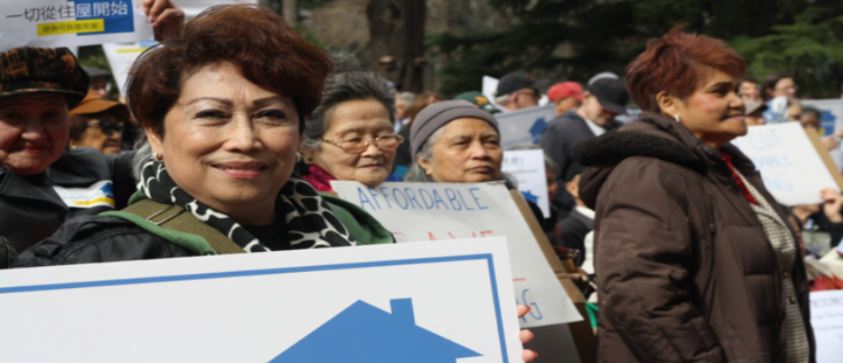
Work Inside and Outside of
Electoral Politics and the Democratic Party
To accomplish this, organizations, movements and individuals on the progressive to left side of the political spectrum must be effectively positioned within the electoral system, as well as able to mobilize independent, non-electoral initiatives and protests outside of it.
Given the structure of the U.S. electoral system this means pursuing an inside/outside approach aimed at building a progressive wing of the Democratic Party powerful enough to influence the platform and direction of the party as a whole.
[For more on inside/outside, see ‘The Electoral System’ module in the Elections 2016 Curriculum.]

Slide 22
The “Inside” Game
The social movement left has mostly kept its distance from electoral politics. This moment requires a qualitative expansion of the energy, resources and analytic attention devoted to the “inside” dimension of inside/outside strategy.
Many groups are already pursuing that approach, including Our Revolution, MoveOn, Working Families Party, ColorofChange, New Virginia Majority, New Florida Majority, and many others. They must be resourced and strengthened.
And we will need powerful new vehicles aimed at engagement in partisan politics, voter registration and mobilization, defense of voting rights, training and fielding candidates, etc.
Liberal cities, states and regions will be especially important sites of resistance to Trump's agenda, and for developing alternative policy platforms and governing models.
In addition to limiting Trump to one term, it will be critical to fight and, where possible, defeat his appointments and policy initiatives.

Slide 23
Grow and Strengthen the “Obama Coalition”
The “Obama Coalition” is the core of a winning political alignment capable of limiting Trump to one term. Obama was put in office by the Rising American Electorate, that is, Black, Brown and Asian voters, unmarried women, working families, union members, LGBTQ voters and young voters. To different degrees, these groups have become more politically progressive in the past few decades. They are the key sectors of an anti-Trump majority and we need to maximize their organization and mobilization.
Race is at the center of the political divide, and peoples of color are the most consistently progressive force in the country. Their mobilization and organization is central to the “Obama Coalition,” but nowhere near enough by itself.
We need to build out from the Rising American Electorate, and broaden our geographical reach.

Slide 24
White People Can Be Won To Oppose Trumpism
Trump won the presidency on the basis of white fear and racial divisiveness. He will not be unseated without a successful appeal to at least some of the white voters who put him in office.
White people constitute a substantial majority of the electorate, about 70%. Mobilizing the Rising American Electorate must be combined with careful attention to both sustaining an allegiance to progressive politics among the white voters that are part of the RAE and undercutting Trump’s base of support among working and middle class whites.
Groups that already organize large numbers of White people – unions, environmental groups, women’s organizations, peace groups, legal rights groups, grassroots organizations and other formations – all have a critical role to play in projecting messages that center anti-racism in the fight for democracy while speaking to the legitimate grievances of working class whites. Multi-racial organizing will be critical to developing the relationships, analysis, and approaches necessary to build a viable progressive alternative to Trumpism.

Slide 25
But Only If We Do the Work
On-the-ground organizing in poor and working class white communities is clearly an immediate and long-term priority. This work could begin by lifting up the voices of the millions of white working people who opposed Trumpism. Effective organizing among poor and working class white people will build on successful models of organizing that are already in play, but are seriously under-resourced.
The long-term work to peel away sections of Trump’s base must speak to those who voted for him despite his racism, not because of it. Some will likely experience “buyer’s remorse” in the coming years, and look for alternatives that address their economic concerns.
Racism has been used to mobilize whites as agents of their own economic destruction. Moving a progressive agenda centered on economic, racial and gender justice requires that working class whites move beyond the self-defeating politics of white racial solidarity to pursue common multi-racial interests.
While we must be unrelenting in our fight against right-wing leaders, both those within and those outside of government, we must learn to do so without demonizing all who are attracted to their ideas. Indeed, we must believe wholeheartedly in their ability to change.

Slide 26
Centrist Democrats have, for decades, delivered for corporate interests at the expense of working people. Their policies have exacerbated income and wealth inequality, hardened racial disparities and devastated communities across the nation. And yet...
As long as Trumpism holds substantial governmental power, corporate Democrats can and must be part of the opposition to the extreme right. At the same time, their agenda cannot anchor a successful fight against Trumpism, and these Democrats are often our main opposition in local and state battles in ‘blue areas.’
The corporate wing of the Democratic Party has its own reasons to fear and distrust Trump and Trumpism. Dumping Trump means developing a sophisticated unity and struggle relationship with centrists. Progressive forces do not currently have the base or the power to go it alone.
Fighting all our adversaries at once is a recipe for failure. We also fail if, in the name of defeating the far right, we are unwilling or unable to project our own agenda and mobilize people nationwide on behalf of democracy, equality, justice and peace.
Bernie Sanders’ campaign, and Jesse Jackson’s bid in the 1980s, demonstrated that a vital factor in gaining truly nationwide reach is creating a platform for a standard-bearer with an inspiring, compelling message. The shortcomings of these pioneering efforts are also instructive: the failure of the Rainbow Coalition to organizationally cohere post-election and Sanders’ failure to give adequate attention to anti-racism. It is on us to build nationwide formations that pursue an inside-outside strategy more effectively and durably than what has come before.
Unity & Struggle with Centrist Democrats

Slide 27
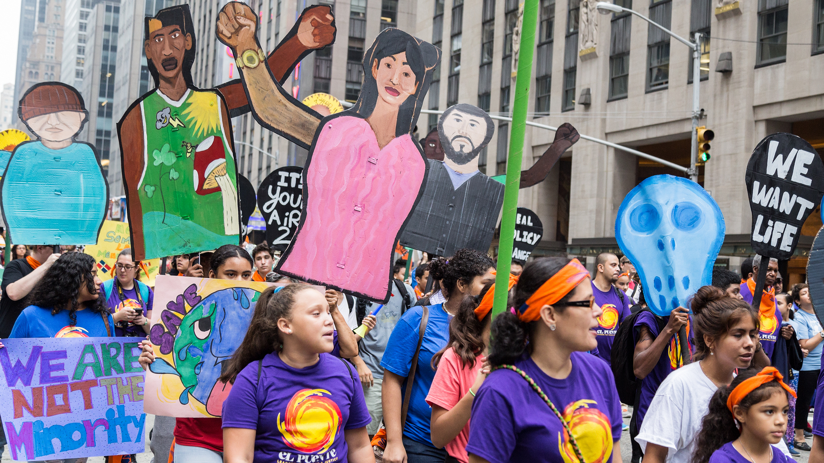
Part IV:
Changed Terrain Demands a New Orientation

Slide 28
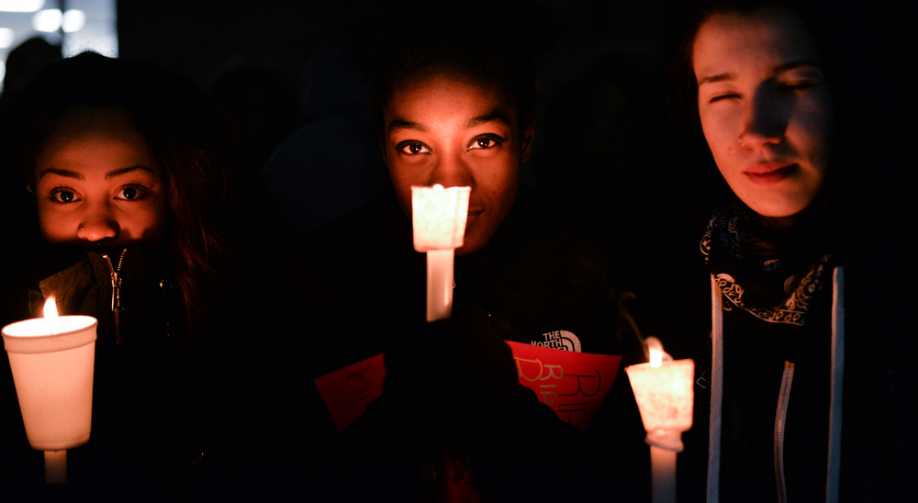
Be Fierce in the Face of Our Enemies Be Open-Hearted with Our People
We will need to be incredibly fierce in challenging the racism, xenophobia and misogyny that the Trump administration will advance. At the same time, we will need to be gentler, more expansive and more forgiving with each other, even across differences of power, position and privilege. If we are going to organize millions, we will need to bring our best selves, combining humility with courage and ambitious vision.
This is new political terrain for everyone. We must take new risks. We will make mistakes and differ over tactics. Sum up and move forward toward our common objectives.

Slide 29
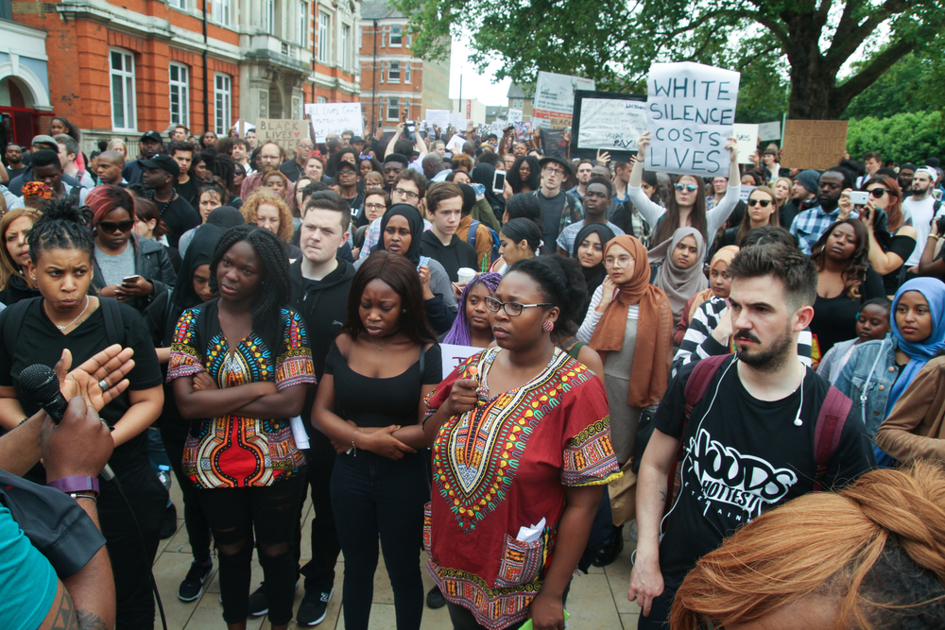
Think in Terms of the Whole
Many social justice organizations have been doing groundbreaking work rooted in low-income communities of color or in other key sectors. Issue-based organizing has been critical to a multitude of substantive democratic victories. But this moment of unprecedented danger to our rights calls on us to step up and take responsibility for the whole. We have to build on the strengths we have gained through our focus on the impact of racism, sexism and economic inequality on specific communities and constituencies and learn to speak to the conditions of all poor and working people in our multi-racial, multi-ethnic country. The task before us to learn to lead the nation as a whole.

Slide 30
Tell a New Story
Push back against the cloudy thinking that reduces the conversation about the working class to a focus on the economic distress of white people. The U.S. working class is multi-racial and multi-ethnic. Some racial groups and geographic communities have suffered disproportionately. All sectors deserve economic and social policies that raise their living standards and ease their distress.
Economic populism that fails to account for historic and current racial inequities within the working class cannot provide the foundation for a powerful progressive movement that sparks and incorporates the creative resistance of people of color.
While racial justice movements have addressed the relationship between race and class in communities of color, we have not consistently weighed in on the larger public debate about economic inequality and the impact of public policy on working people as a whole.
We need to stop waiting for pundits or the Democratic establishment to get the story right. That isn’t going to happen. It is up to us to craft a different story about race, class, gender and nation that makes coherent meaning of our experience and our pain.
This new story will need to combine economic populism and anti-elitism with full-throated, consistent attention to racial and gender justice. Crafting a new story of who “we” are as a people will draw on the distinct experiences of our diverse communities while also speaking to the common interests of all poor and working people in this country.

Slide 31
Unite Across Differences
Resonate with Millions to Oppose Trump
There is no single approach to accomplishing our objectives:
Dump Trump in 2020
Defend Our Communities
Advance Progressive Unity, Build Progressive Power
We will need people engaged in strong street protests, and we will need mass candlelight vigils.
We will need community defense, grassroots organizing and powerful electoral work.
We will need movements rooted in particular identities and focused on specific issues.
We will need multi-racial and cross-class organizing.
With ample space for all these approaches and more, we must tirelessly seek unity in pursuit of shared goals, amplify our voices and our agenda, and resonate with each other and with the millions who will be united in opposition to Trump and Trumpism.

Slide 32
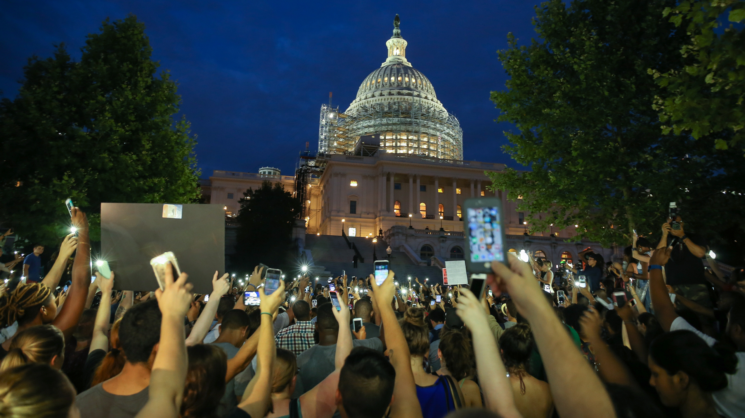
This discussion guide was developed by Linda Burnham, Max Elbaum, Harmony Goldberg, Jason Negrón-Gonzales, Tarso Ramos and Bob Wing. The guide, along with a supplementary resource list, can be downloaded at www.organizingupgrade.com. A three-part curriculum about the 2016 presidential election, authored by the same team, can also be found at that site. To contact us: electioncurriculum@earthlink.net.

